Slide 1

Swiggy Delivery Time Prediction
Emmadi Srikar
Batch No :436
Innomatics Research
Labs Dilshuknagar

Slide 2
About me
I am Emmadi Srikar.
I completed my B.Tech in Computer Science and Engineering from St Mary’s Group of Institution Hyderabad.
LinkedIn : https://www.linkedin.com/in/emmadi-srikar-03baaa337
Github : https://github.com/srikar42

Slide 3
AGENDA :
Business Problem
Problem statement
CRISP-ML(Q) Methodology
Dataset Overview
Data Understanding
Data Preprocessing & Encoding
Feature Scaling & Selection
Model Building
Challenges Faced
Conclusion

Slide 4
Business Problem :
Swiggy processes millions of food-delivery journeys across hundreds of cities every month. Accurate Estimated Time of Arrival (ETA) at order placement and during delivery is core to the customer experience — it affects conversion, cancellations, ratings, and retention. Today’s ETA accuracy suffers from many sources of uncertainty: highly variable traffic patterns, weather events, restaurant preparation variability, rider behaviour and skill, order batching/multiple deliveries, and city-specific operational constraints.
Inaccurate ETAs cause:
● Reduced customer trust and lower repeat orders.
● Increased cancellations and refund costs.
● Higher support volume and operational interventions.
● Sub-optimal rider allocation and increased rider idle or overtime costs.

Slide 5
Problem Statement :
Swiggy’s objective is to predict the delivery time (minutes) per order at the moment of order placement (and update it dynamically), with business-grade accuracy and uncertainty estimates so the platform can
(a) show reliable ETAs to customers
(b) optimize rider allocation. Building a production-ready, scalable Machine Learning system that predicts per-order delivery time (in minutes) using real-time and historical features (order, rider, restaurant, traffic, weather, and temporal signals)

Slide 6
CRISP-ML(Q) Methodology :
Business & Data Understanding
Data Preparation (cleaning, encoding, scaling)
Modeling (train multiple ML models)
Evaluation (R²,RMSE)
Deployment (Streamlit)

Slide 7
Dataset Overview :
Column Name | Description
rider_id | Unique identifier for each delivery partner
age | Age of the delivery partner
ratings | Average customer rating of the rider
vehicle_condition | Condition of vehicle (0 = Poor, 1 = Average, 2 = Good)
type_of_vehicle | Vehicle used for delivery (motorcycle, scooter, etc.)
type_of_order | Type of food ordered (snack, meal, drinks, buffet)
multiple_deliveries | Number of deliveries assigned in a single trip
pickup_time_minutes | Time taken by restaurant to prepare the order (minutes)
restaurant_longitude | Longitude of the restaurant location
delivery_longitude | Longitude of the customer delivery location
is_weekend | Whether the order was placed on a weekend (Yes/No)
order_time_hour | Hour when the order was placed (0–23)
order_time_of_day | Time bucket (morning, afternoon, evening, night)
weather | Weather during delivery (sunny, cloudy, fog, stormy, sandstorms)
traffic | Traffic condition during delivery
festival | Whether the order was placed on a festival day (Yes/No)
city_type | Classification of city (urban, metropolitan)
city_name | Name/code of the city (BANG, HYD, CHEN, etc.)
time_taken | Actual delivery time (minutes) — Target Variable
distance | Distance between restaurant and delivery location (km)
order_date | Date when the order was placed
order_day | Day of the month
order_month | Month of the order
order_day_of_week | Day of the week (Monday–Sunday)

Slide 8
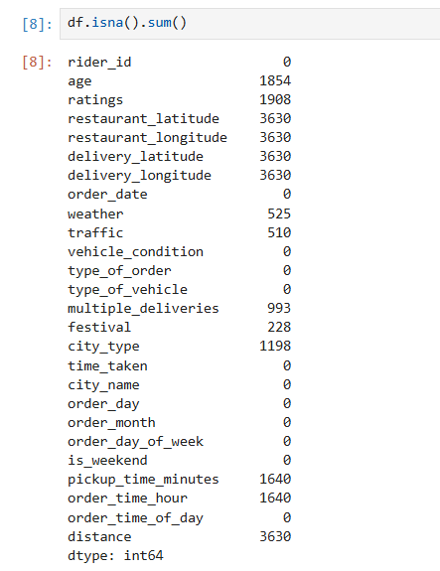
Data Understanding :
Checked:
Dataset shape
Data types
Missing values
Duplicates
Visualized distributions using KDE plots.

Slide 9
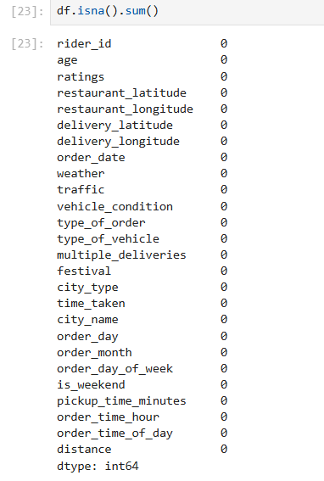
Data Preprocessing :
Imputed missing values using:
Rider-wise mean (age, ratings)
Mode (weather, traffic, festival, city type)
Median (multiple deliveries)
Domain-based values (pickup time)
Ensured dataset had no nulls.

Slide 10
Encoding Categorical Variables :
Converted categorical features to numeric:
One-Hot Encoding : weather, order type, vehicle type, city, time of day
Ordinal Encoding : traffic (low < medium < high < jam)
Removed original categorical columns after encoding.

Slide 11
Feature Scaling :
Applied StandardScaler to numerical features :
age, ratings, distance, order time, pickup time, traffic, etc.
Purpose:
Bring features to same scale
Improve model performance & stability.

Slide 12
Feature Selection :
Used multiple techniques:
Correlation analysis with target
SelectKBest
Mutual Information
Final selected features:
age, ratings, vehicle_condition, multiple_deliveries, distance
traffic, festival_yes, order_time_hour
order_time_of_day_morning, weather_sunny, city_type_urban

Slide 13
Model Building :
Trained and compared :
Linear Regression
Decision Tree
KNN
Ridge & Lasso
Random Forest (Best performer)
Metric used: R² Score

Slide 14
Cross-Validation :
Used 5-Fold Cross Validation.
Purpose: Ensure stable performance Reduce dependency on one train-test split
Random Forest showed consistent R² across folds.

Slide 15
Hyperparameter Tuning :
Applied:
GridSearchCV (exhaustive search)
RandomizedSearchCV (faster search)
Tuned parameters:
n_estimators
max_depth
min_samples_split
min_samples_leaf
max_features
Selected best parameters for final model.

Slide 16
Final Model & Performance :
Final model: Random Forest Regressor (tuned)
Trained on full dataset using selected features.
Achieved strong R² and stable performance.
Model ready for deployment.

Slide 17
Deployment (Streamlit) :
Saved model and feature order using pickle.
Built Streamlit UI for real-time predictions.
Users can input: Rider details Distance Traffic Time Features
Output: Estimated Delivery Time (minutes)

Slide 18
Business Impact :
More accurate ETA’s : Higher Customer Trust
Reduced cancellations & support tickets.
Better rider allocation & operational efficiency
Scalable ML solution for production.

Slide 19
Challenges Faced :
Handling missing values without losing data
Encoding high-cardinality features (city_name)
Choosing best model among many
Preventing Overfitting

Slide 20
Conclusion :
Built a complete ML solution for ETA prediction
Followed industry methodology (CRISP-ML(Q))
Deployed as a real-time web application
Ready for real-world extension and scaling

Slide 21

THANK YOU

